Slide 1
Austin .NET User Group DevOps in a Cloud World
Shawn Weisfeld
Cloud Solution Architect
Microsoft

Slide 2
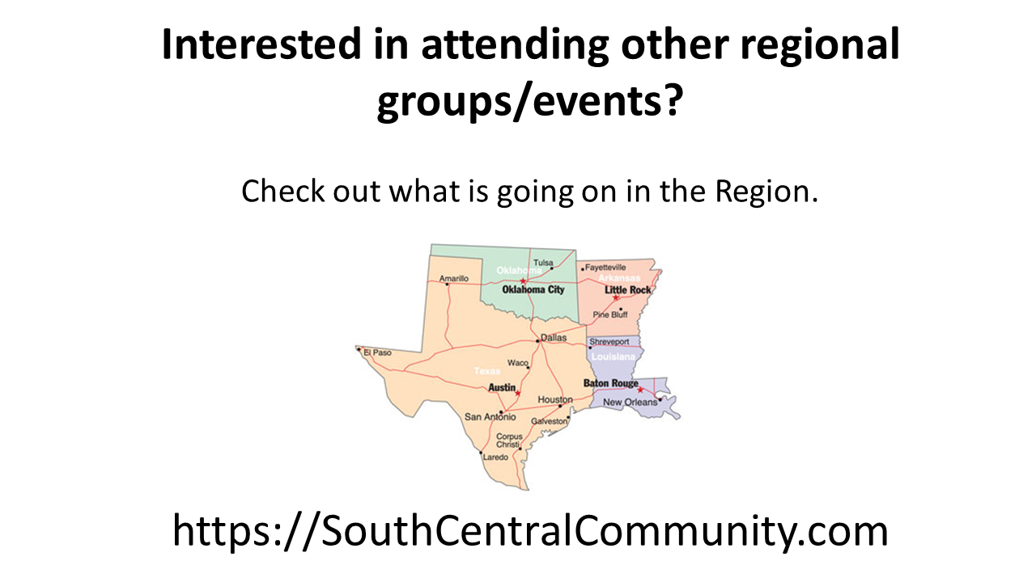

Slide 3


Watch User Group presentations for FREE online! We now have over 850 presentations online
Miss a User Group meeting?
Forget something that you learned?
Want to see content from a User Group not in your area?
Want to share with a buddy?
Presentations from the thought leaders on the topics you care about including:
Agile
Azure
C#
Entity Framework
HTML5
MVC
SQL
jQuery
and Much More!
We know you cannot make it to every session,
that is why we post them online for you!
New Content added all the time!
For new content announcements
@UserGroupTV
http://www.UserGroup.tv

Slide 4

About Me
Shawn Weisfeld
Cloud Solution Architect
Microsoft – One Commercial Partner Technical Team
sweisfel@microsoft.com
Austin, TX

Slide 5
WHAT IS DEVOPS?

Slide 6
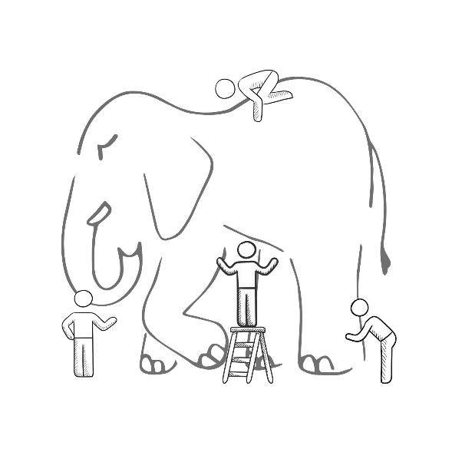
WHAT IS DEVOPS?
It’s a job title
It’s automation
It’s Development and Operations collaboration
It means faster and smaller releases

Slide 7
What is DevOps?
People. Process. Products.
Build& Test
Deploy
DevOps is the union of people, process, and products to enable continuous delivery of value to your end users.
“
Continuous Delivery
Develop
Operate
”
Plan & Track
Monitor & Learn

Slide 8


Slide 9
How Microsoft can help
Microsoft Azure is a powerful and flexible foundation for past, present, and future apps – easily build, manage, and deploy any application and any stack on a massive, global network using your favorite tools and frameworks.
Flexible
Powerful
Open
Choice of IaaS, PaaS, public cloud or hybrid.
Mirror or modernize app infrastructure with VMs, containers, microservices or serverless.
Supports all stages of the app modernization journey – from lift-and-shift to Cloud-Native.
Instantly improve the performance, scalability and resiliency of your apps by moving them to the cloud.
Increase business agility with Cloud-Native capabilities and built-in DevOps for continuous innovation.
Bring your stack, we bring a cloud that runs any app, on any platform, and any language.
Build applications using the language and tools of your choice - Azure supports what you already use and love so you can get up and running fast – just bring code.

Slide 10
What technologies do I need to support DevOps?
DevOps brings together people, processes, and products, automating software delivery to provide continuous value to your users. Using Azure DevOps, you can deliver software faster and more reliably - no matter how big your IT department or what tools you’re using.
Continuous integration (CI)
Improve software development quality and speed.
When you use Azure Pipeliens or Jenkins to build apps in the cloud and deploy to Azure, each time you commit code, it’s automatically built and tested and bugs are detected faster.
Continuous Deployment (CD)
By combining continuous integration and infrastructure as code (IaC), you’ll achieve identical deployments and the confidence to deploy to production at any time.
With continuous deployment, you can automate the entire process from code commit to production if your CI/CD tests are successful.
Continuous Learning & Monitoring
With Azure Application Insights you can identify how your applications are performing and test if the recent deployment made things better or worse.
Using CI/CD practices, paired with monitoring tools, you’ll be able to safely deliver features to your customers as soon as they’re ready.

Slide 11





Introducing Azure DevOps
Azure Boards
Azure Pipelines
Azure Repos
Deliver value to your users faster using proven agile tools to plan, track, and discuss work across your teams.
Build, test, and deploy with CI/CD that works with any language, platform, and cloud. Connect to GitHub or any other Git provider and deploy continuously.
Get unlimited, cloud-hosted private Git repos and collaborate to build better code with pull requests and advanced file management.
Azure Test Plans
Azure Artifacts
➔
Test and ship with confidence using manual and exploratory testing tools.
Create, host, and share packages with your team, and add artifacts to your CI/CD pipelines with a single click.
https://azure.com/devops

Slide 12
Azure DevOps
Better together
Azure Boards
Azure Repos
Azure Pipelines
Azure Test Plans
Azure Artifacts
An end-to-end solution for organizations looking for an enterprise-grade toolchain
Fully Integrated with end to end traceability
Scalable to any team and project size
Highly available, multi region, hybrid cloud & on-prem
Customer Support
Consistent admin and access control
➔
https://azure.com/devops

Slide 13










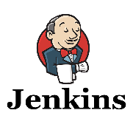
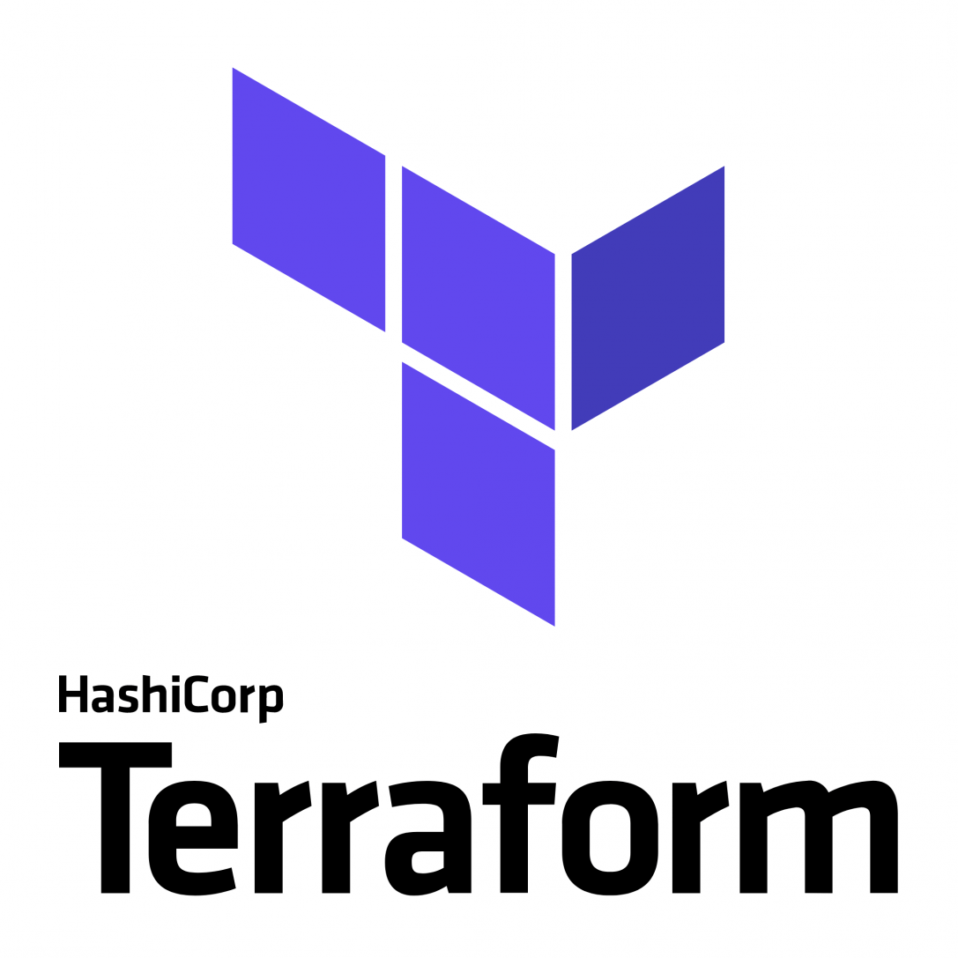

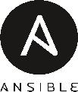



Broadening the Azure Ecosystem
Microsoft
Azure

Slide 14



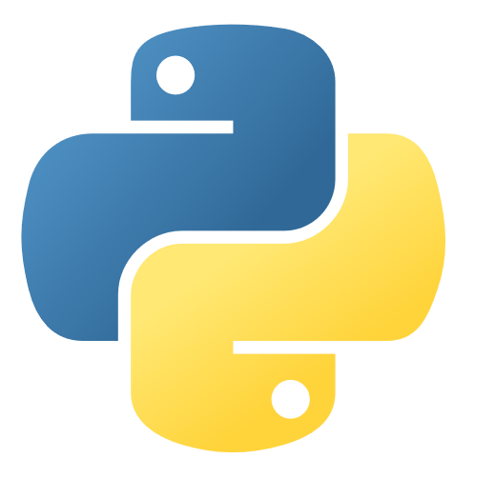
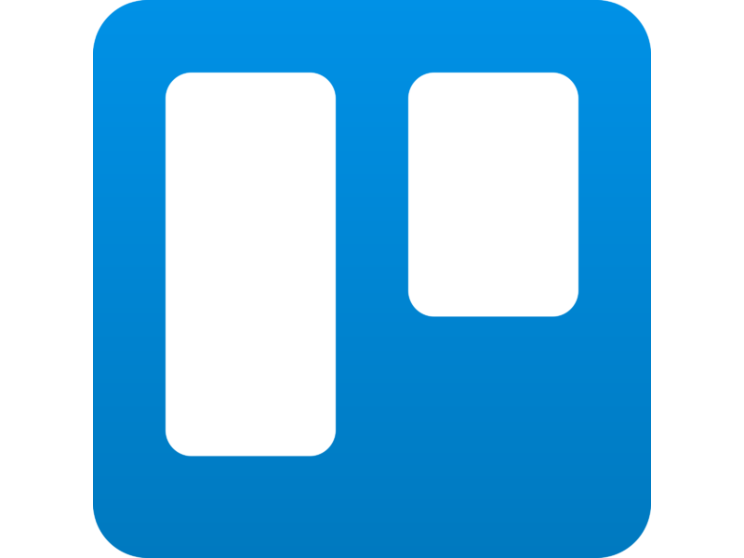
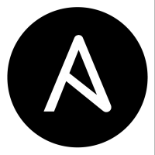

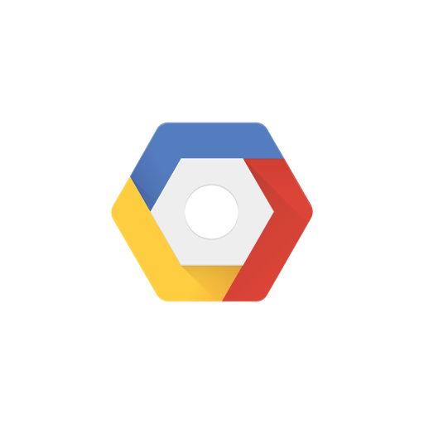

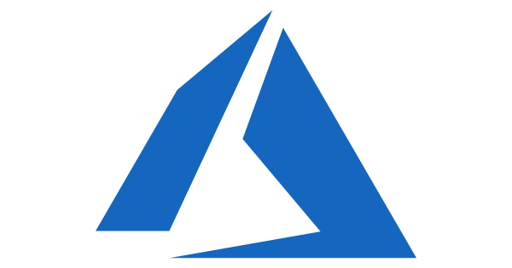

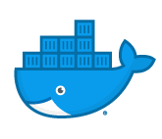
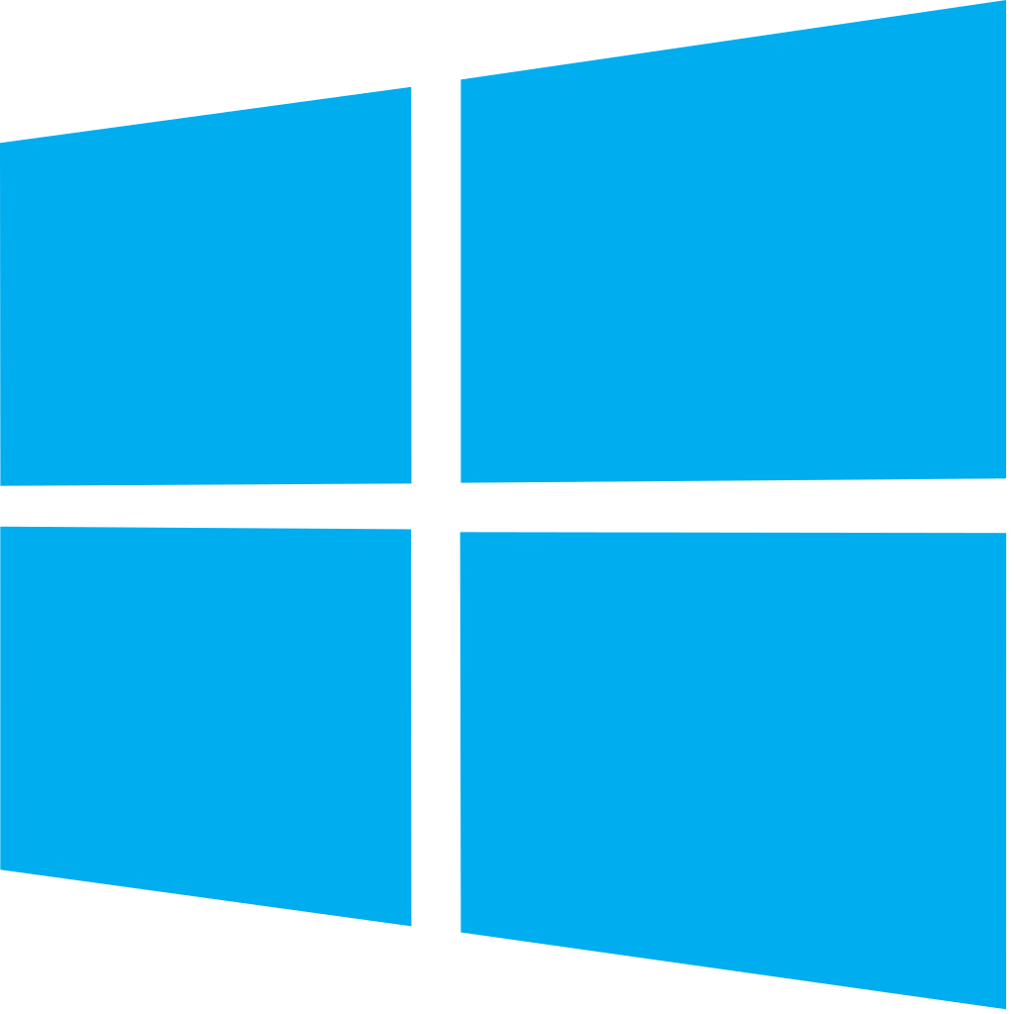


Azure DevOps: Choose what you love
Any Language, Any Platform
Azure DevOps lets developers choose the tools and languages that are right for them
Mix and match to create workflows with tools from Microsoft, open source or your favorite 3rd party tools
Target any cloud, on-prem or both and deploy to the servers you need

Slide 15

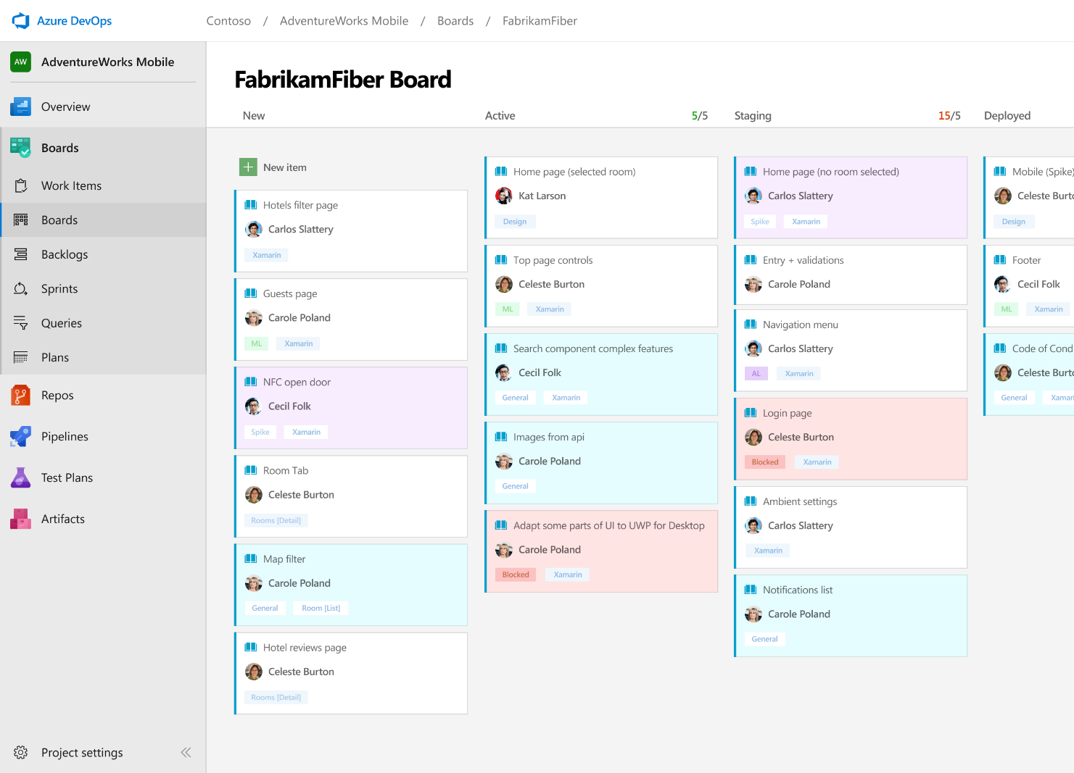



Azure Boards
Track work with Kanban boards, backlogs, team dashboards, and custom reporting
Connected from idea to release
Track all your ideas at every development stage and keep your team aligned with all code changes linked directly to work items.
Scrum ready
Use built-in scrum boards and planning tools to help your teams run sprints, stand-ups, and planning meetings.
Project insights
Gain new insights into the health and status of your project with powerful analytics tools and dashboard widgets.
➔
https://azure.com/devops
@DonovanBrown

Slide 16
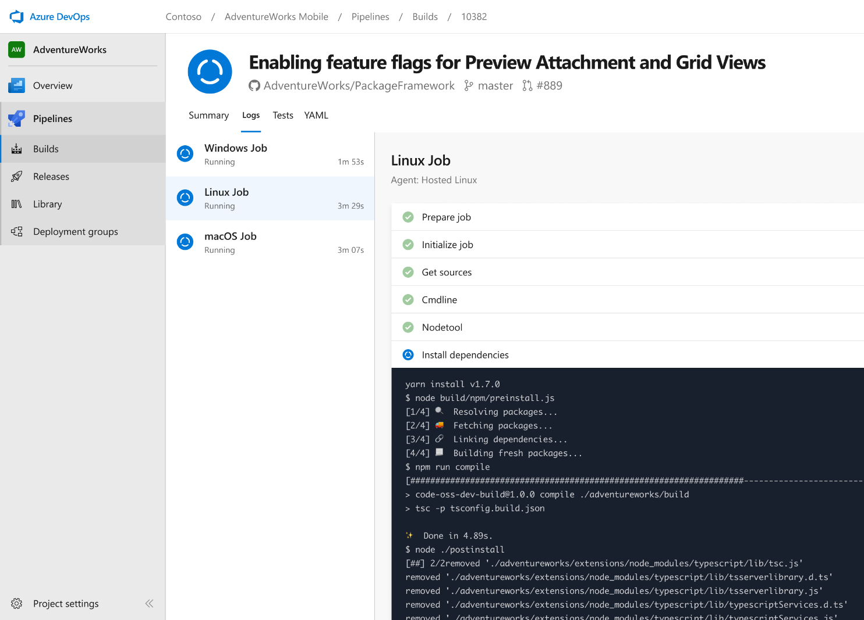


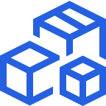
Azure Pipelines
Cloud-hosted pipelines for Linux, Windows and macOS.
Any language, any platform, any cloud
Build, test, and deploy Node.js, Python, Java, PHP, Ruby, C/C++, .NET, Android, and iOS apps. Run in parallel on Linux, macOS, and Windows. Deploy to Azure, AWS, GCP or on-premises
Extensible
Explore and implement a wide range of community-built build, test, and deployment tasks, along with hundreds of extensions from Slack to SonarCloud. Support for YAML, reporting and more
Containers and Kubernetes
Easily build and push images to container registries like Docker Hub and Azure Container Registry. Deploy containers to individual hosts or Kubernetes.
➔
https://azure.com/pipelines

Slide 17

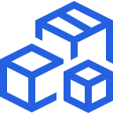

Azure Pipelines
Cloud-hosted pipelines for Linux, Windows and macOS, with unlimited minutes for open source
Any language, any platform, any cloud
Build, test, and deploy Node.js, Python, Java, PHP, Ruby, C/C++, .NET, Android, and iOS apps. Run in parallel on Linux, macOS, and Windows. Deploy to Azure, AWS, GCP or on-premises
Extensible
Explore and implement a wide range of community-built build, test, and deployment tasks, along with hundreds of extensions from Slack to SonarCloud. Support for YAML, reporting and more
Containers and Kubernetes
Easily build and push images to container registries like Docker Hub and Azure Container Registry. Deploy containers to individual hosts or Kubernetes.
Best-in-class for open source
Ensure fast continuous integration/continuous delivery (CI/CD) pipelines for every open source project. Get unlimited build minutes for all open source projects with up to 10 free parallel jobs across Linux, macOS and Windows
➔
https://azure.com/pipelines

Slide 18
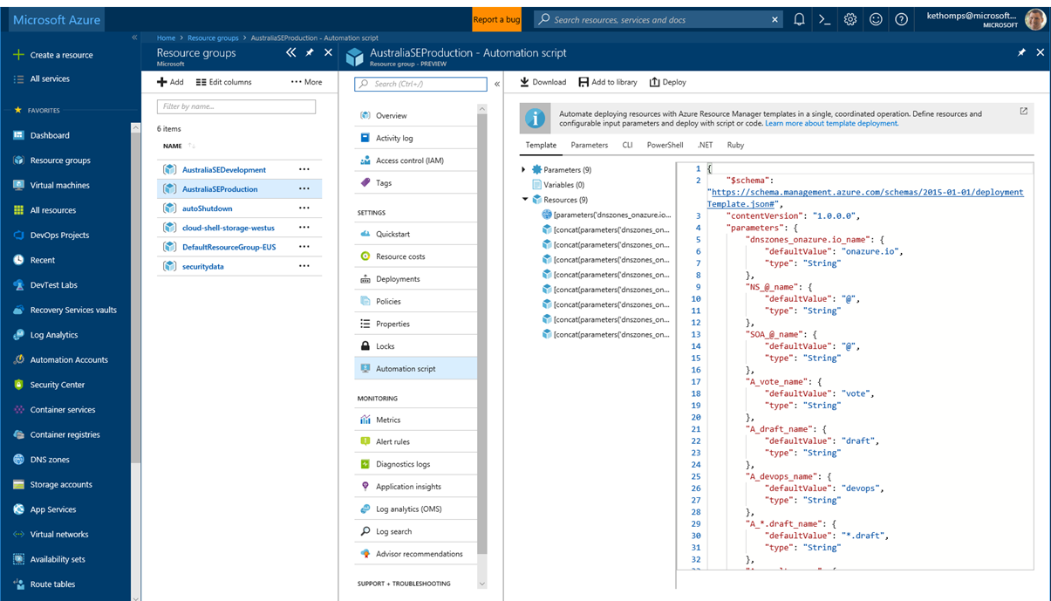
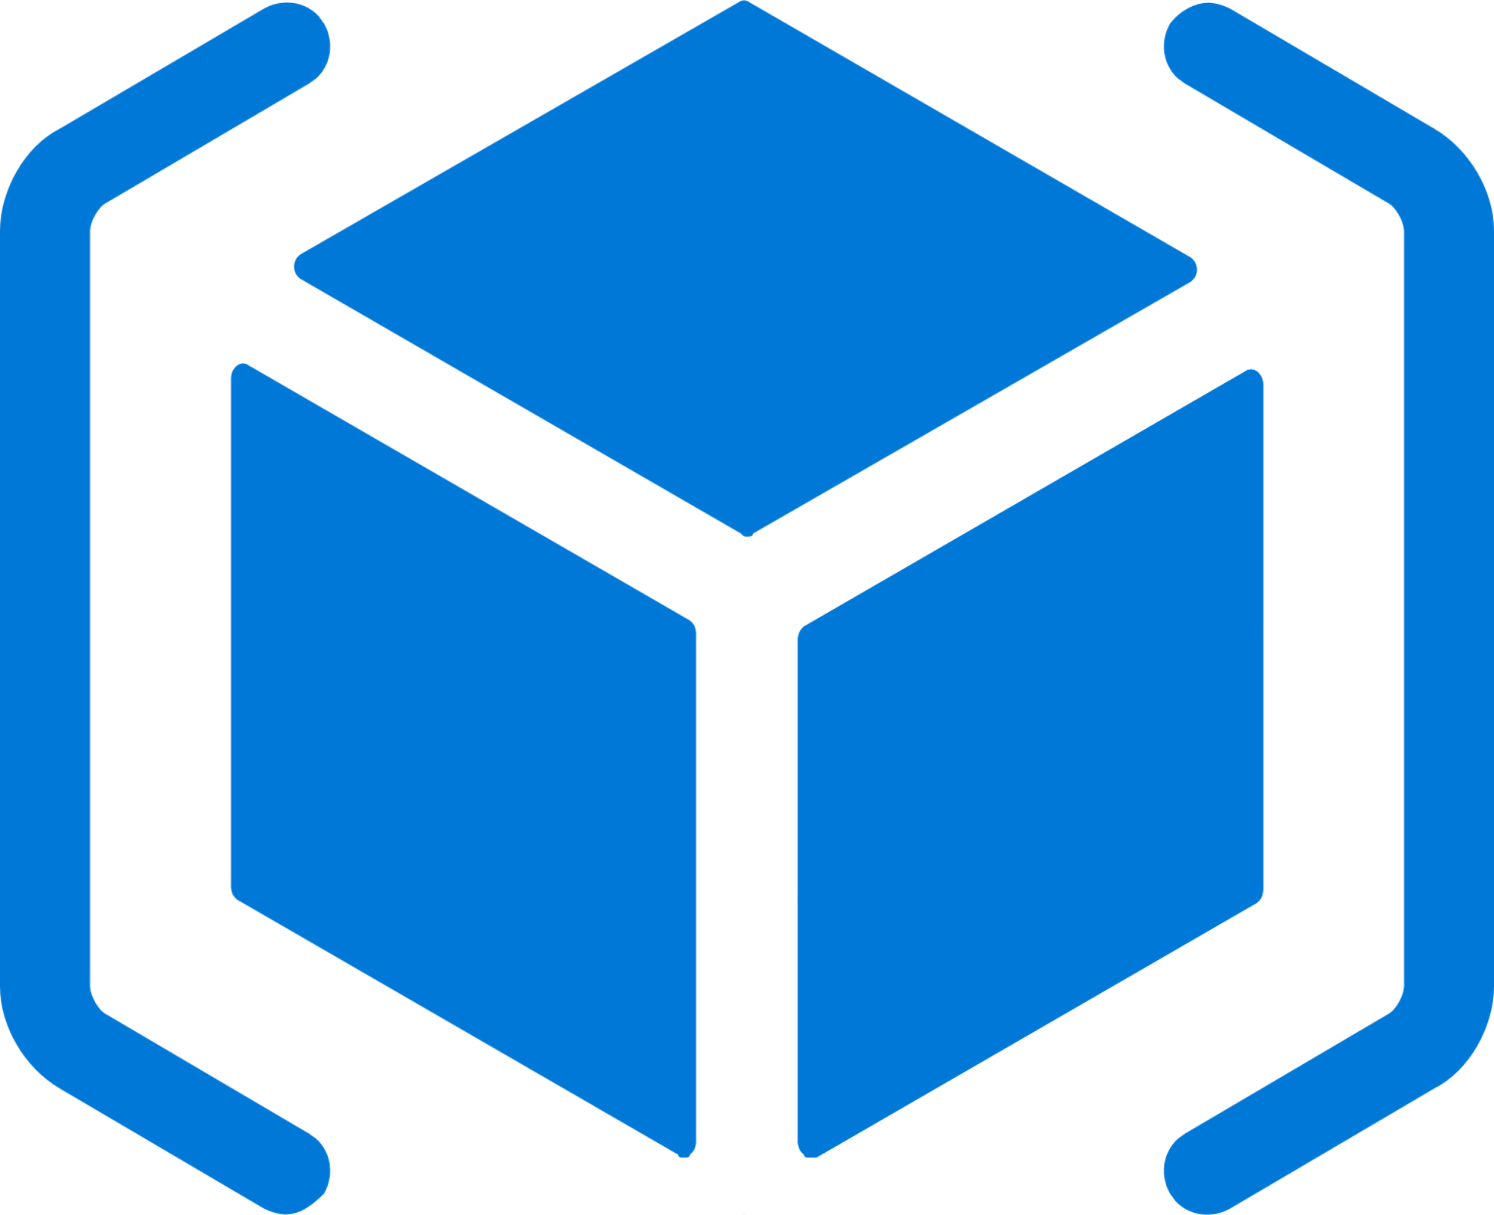


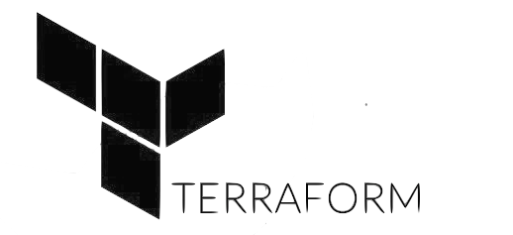
Deploy Repeatedly & Reliably
Azure Resource Manager & DevOps Tool Integrations
Infrastructure as Code, built-in with Azure Resource Manager
Use Azure Automation & Config to automate repetitive tasks
Support for DevOps tool integrations and OSS tooling such as Terraform, Ansible & Chef

Slide 19
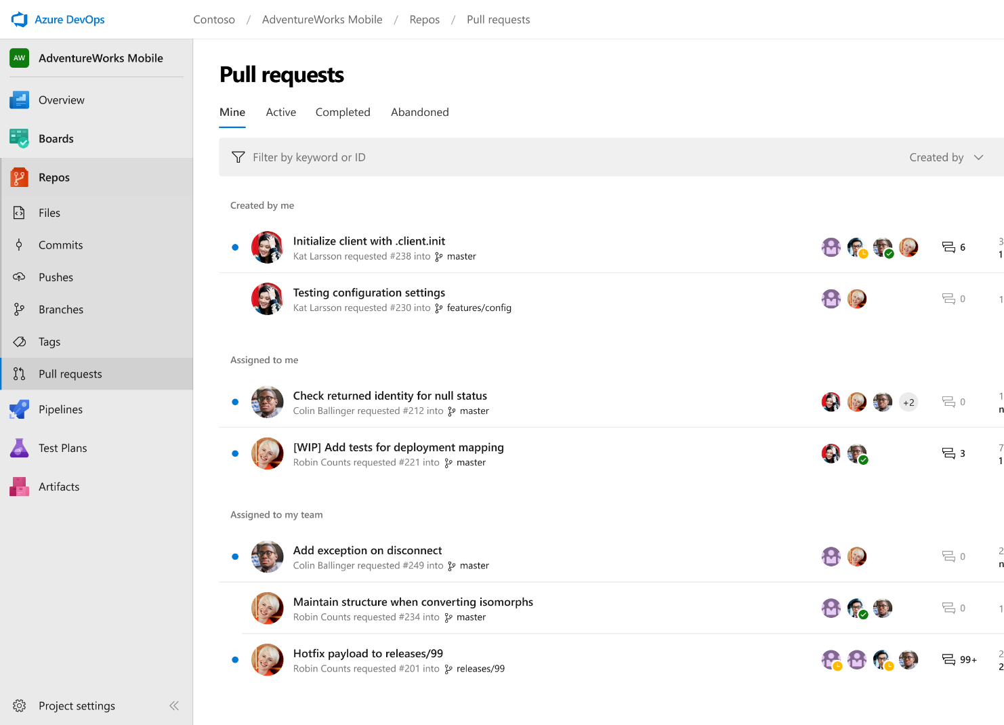



Azure Repos
Unlimited private Git repo hosting and support for TFVC that scales from a hobby project to the world’s largest Git repositories
Works with your Git client
Securely connect with and push code into your Git repos from any IDE, editor, or Git client.
Web hooks and API integration
Add validations and extensions from the marketplace or build your own using web hooks and REST APIs.
Semantic code search
Quickly find what you’re looking for with code-aware search that understands classes and variables.
➔
https://azure.com/devops

Slide 20
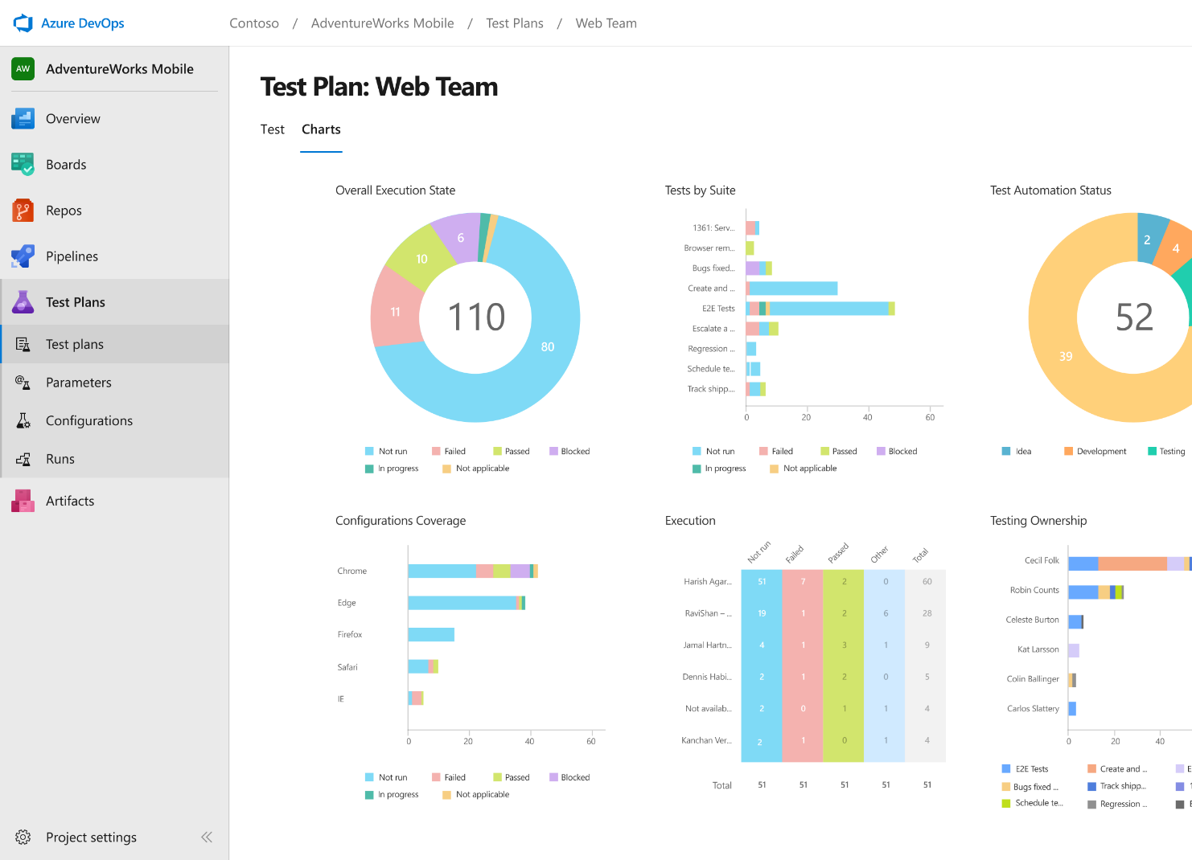
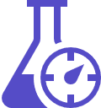


Azure Test Plans
Get end-to-end traceability. Run tests and log defects from your browser. Track and assess quality throughout your testing lifecycle.
Capture rich data
Capture rich scenario data as you execute tests to make discovered defects actionable. Explore user stories without test cases or test steps. You can create test cases directly from your exploratory test sessions.
Test across web and desktop
Test your application where it lives. Complete scripted tests across desktop or web scenarios. Test on-premises application from the cloud and vice-versa.
Get end-to-end traceability
Leverage the same test tools across your engineers and user acceptance testing stakeholders. Pay for the tools only when you need them.
➔
https://azure.com/devops

Slide 21
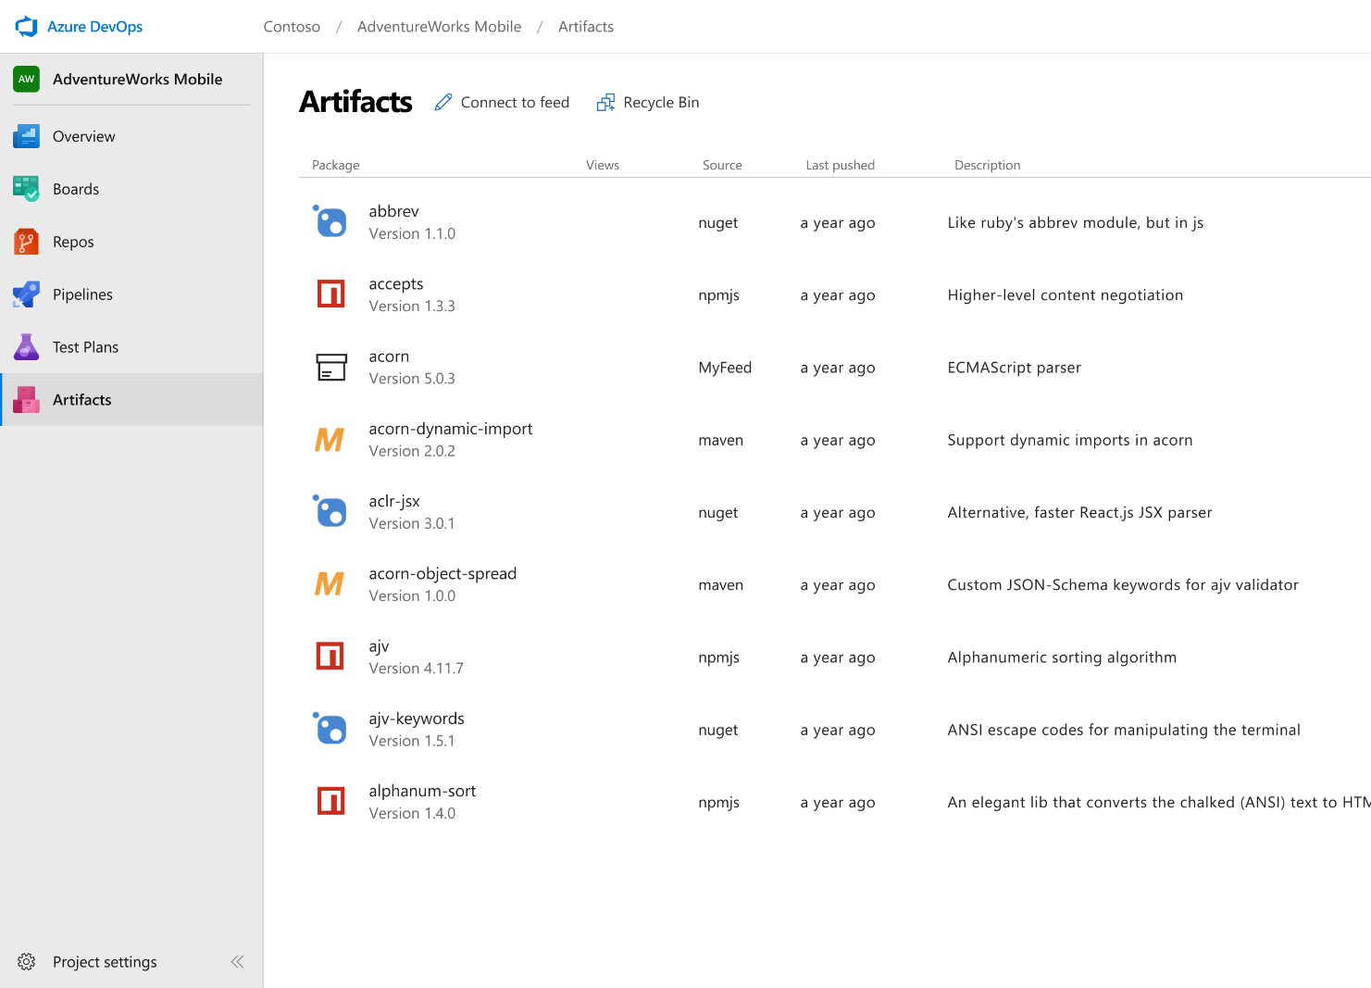



Azure Artifacts
Create and share Maven, npm, and NuGet package feeds from public and private sources – fully integrated into CI/CD pipelines
Manage all package types
Get universal artifact management for Maven, npm, and NuGet.
Add packages to any pipeline
Share packages, and use built-in CI/CD, versioning, and testing.
Share code efficiently
Easily share code across small teams and large enterprises.
➔
https://azure.com/devops

Slide 22
Demo
Notes:
Demo : dev.azure.com

Slide 23
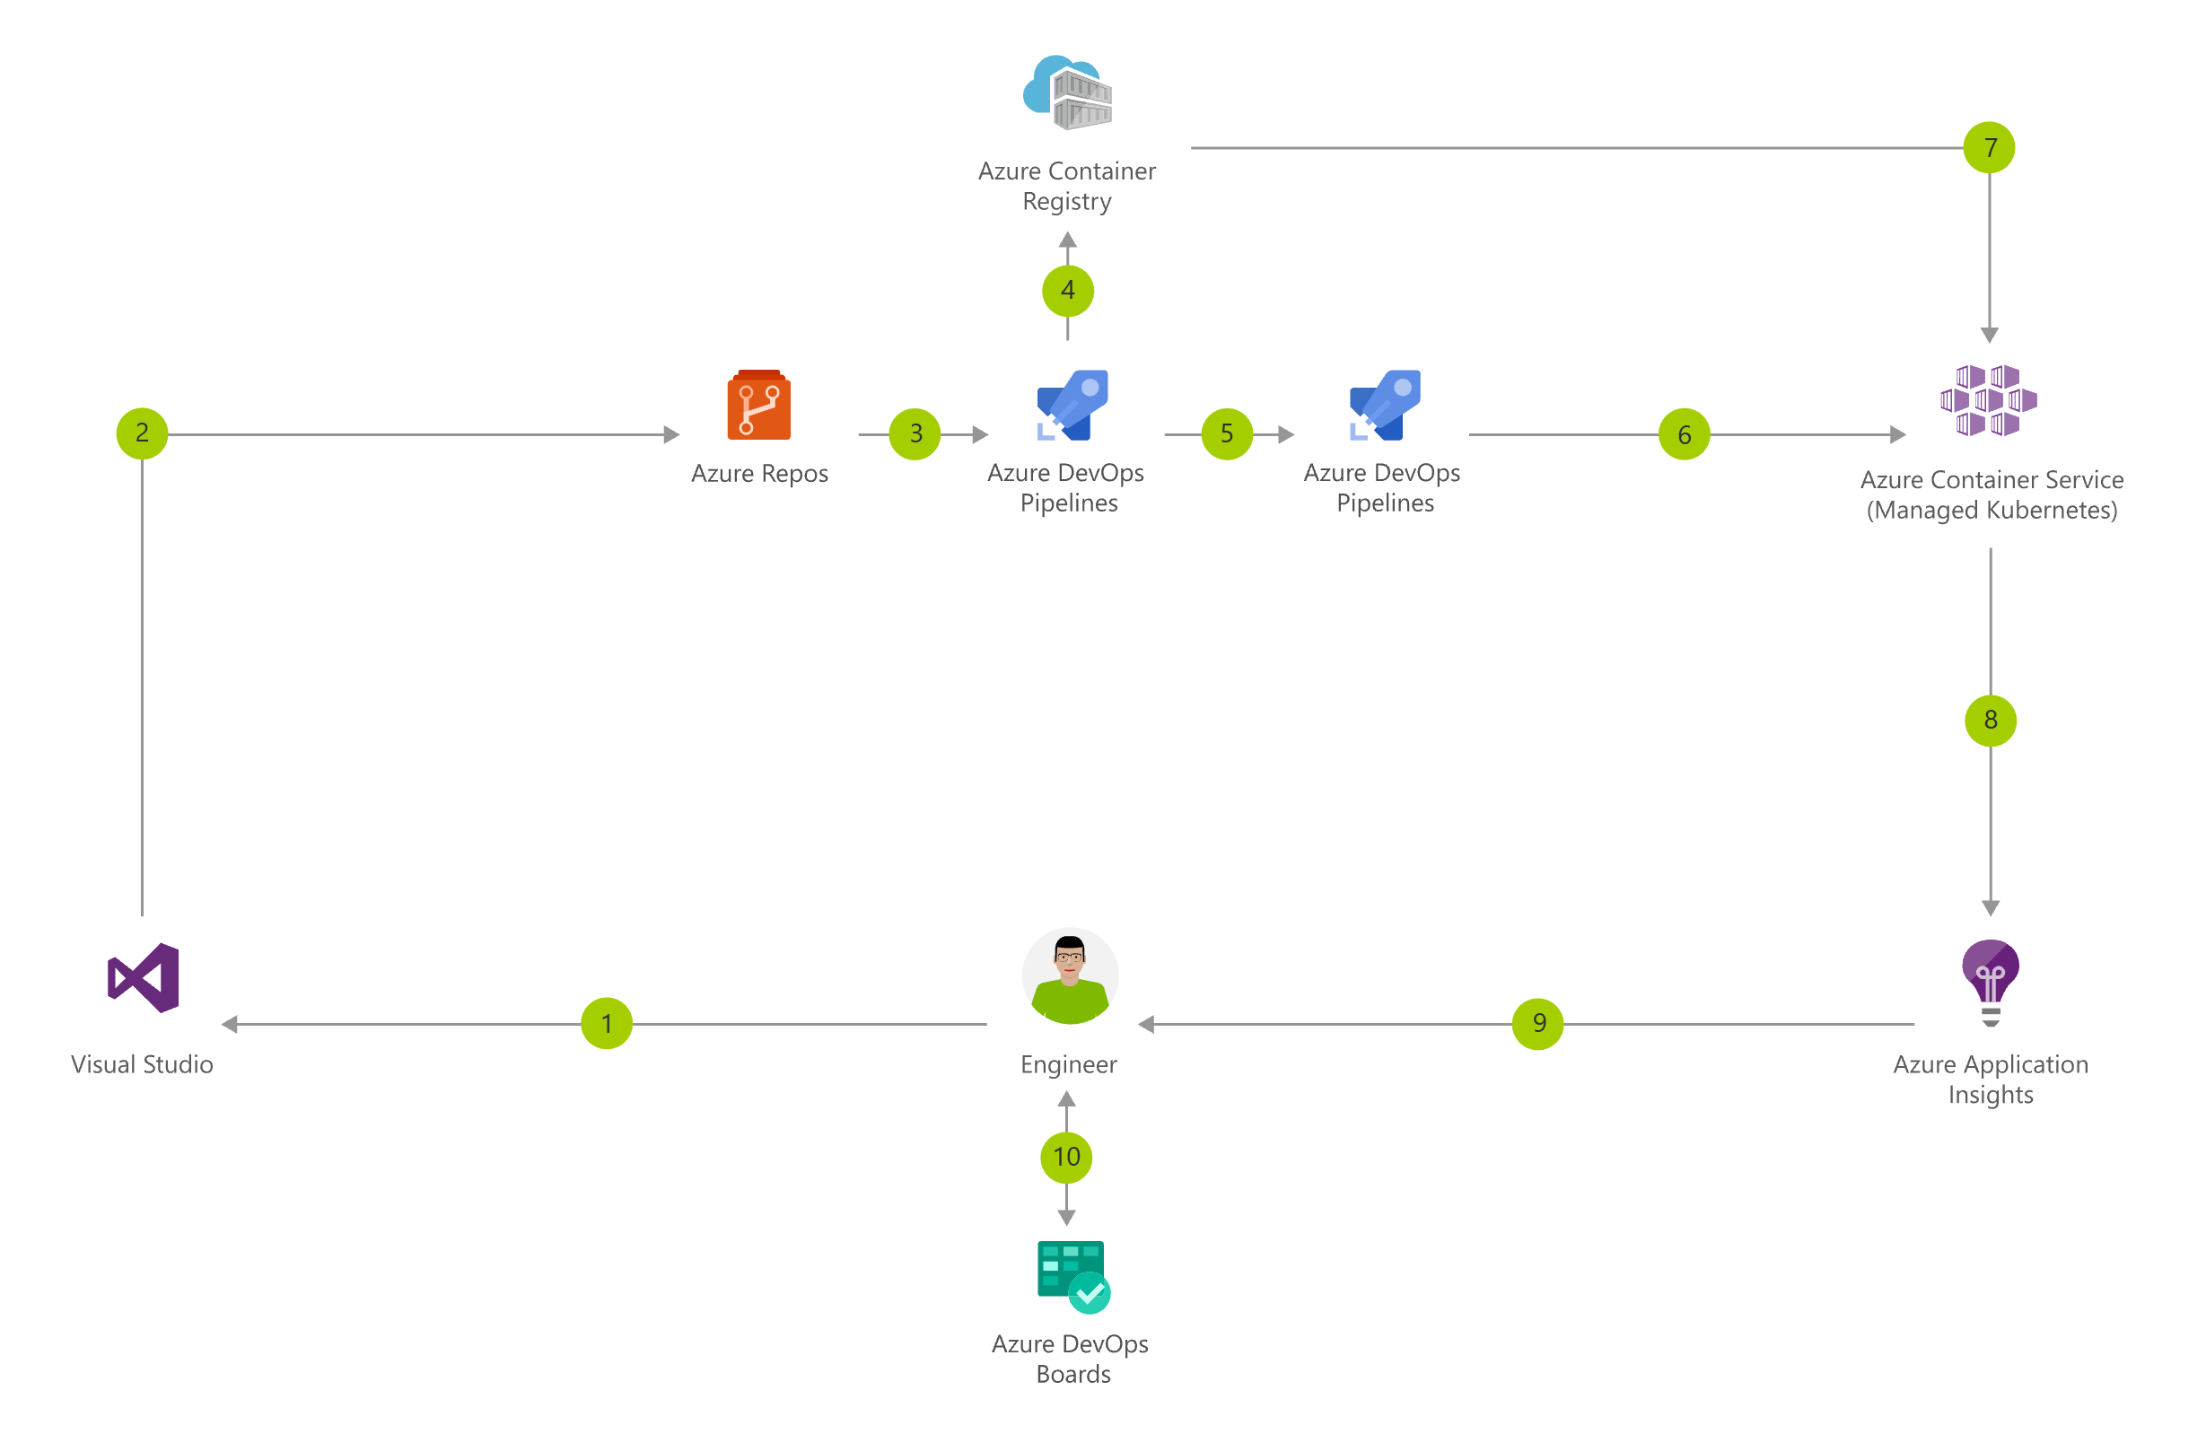
Demo Application
https://azure.microsoft.com/en-us/solutions/architecture/cicd-for-containers/

Slide 24
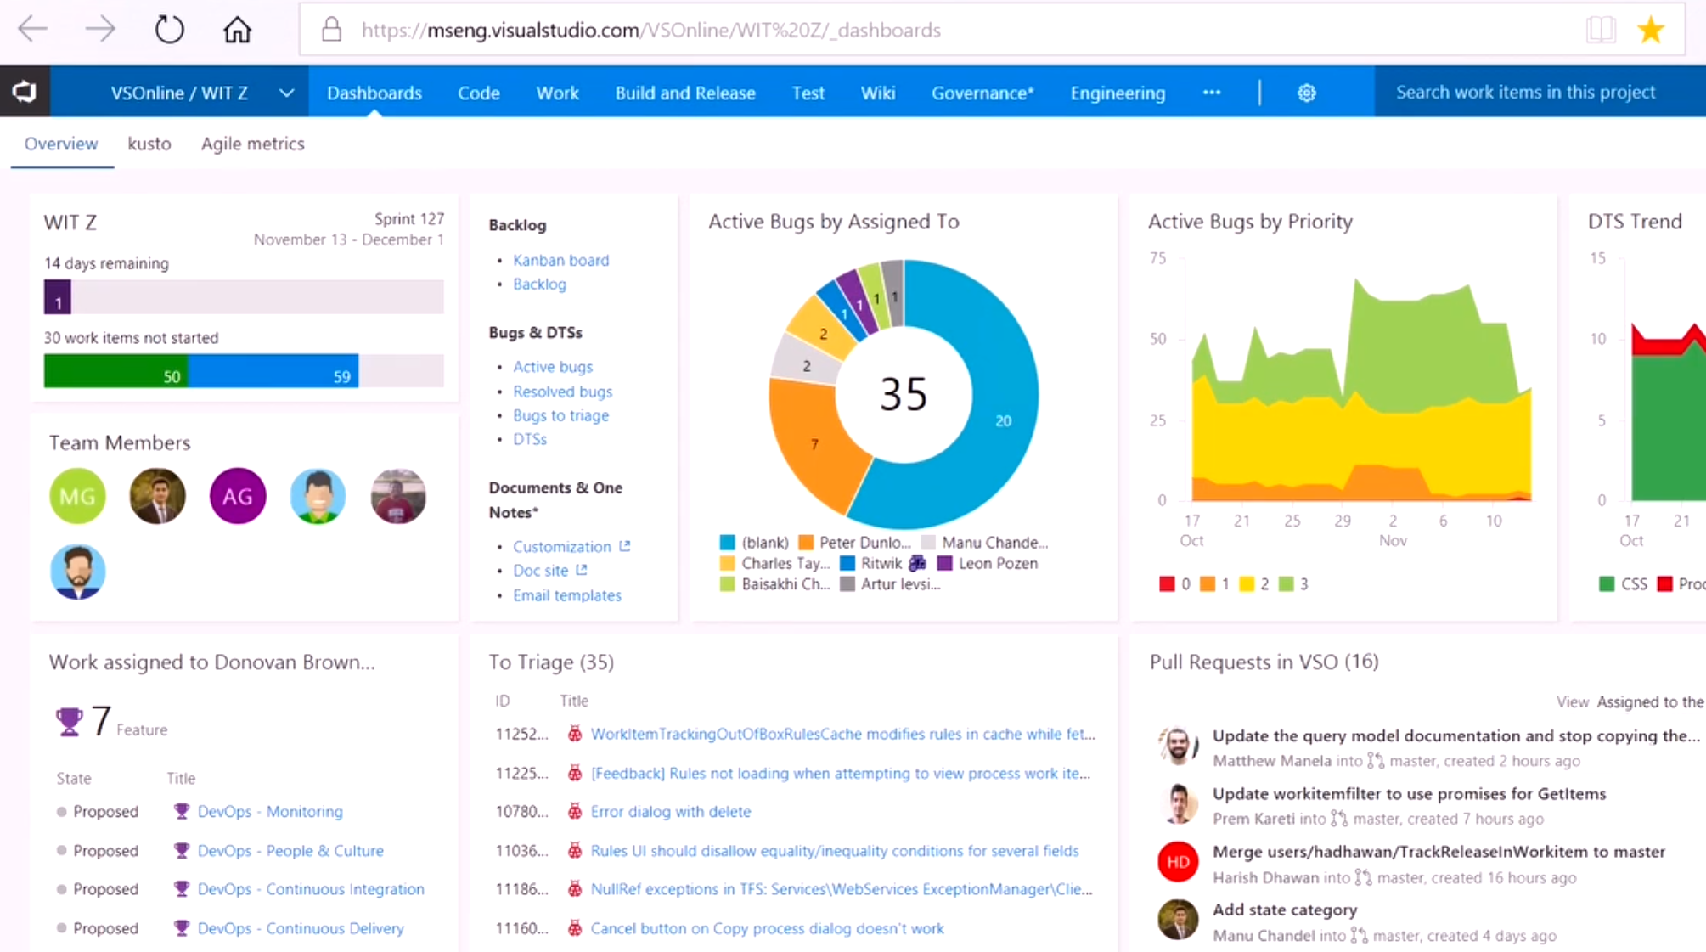
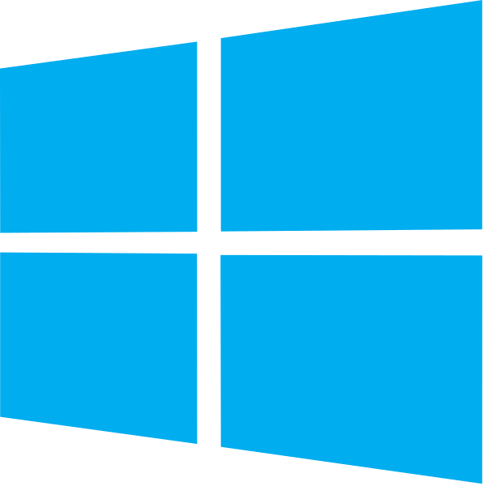

DevOps at Microsoft
DevOps at Scale
Visual Studio Team Services is the toolchain of choice for Microsoft engineering
+85,000
Engineers at Microsoft are using VSTS
Windows Engineering Team
VSTS Engineering Team
VSTS scales to host the world’s largest Git repo
Embracing DevOps practices = More value to customers
300GB Source code
More features delivered to customers in 2016 than in previous 4 years combined
3.5M Files
4,000+ Devs
http://aka.ms/devopsatmicrosoft

Slide 25





Azure DevOps
Plan smarter, collaborate better, and ship faster with a set of modern dev services
Any developer, any platform, any cloud. Full support for hybrid cloud, on-premises & containers.
Use all the Azure DevOps services or choose just what you need to complement your existing workflows
Best in class builds for open source. Free unlimited build minutes for public projects and up to 10 free concurrent pipelines across Windows, Linux and macOS
Get started for free for small teams, scales to support the largest enterprises
Azure Boards
Azure Repos
Azure Pipelines
➔
https://azure.com/devops
Azure Test Plans
Azure Artifacts

Slide 26
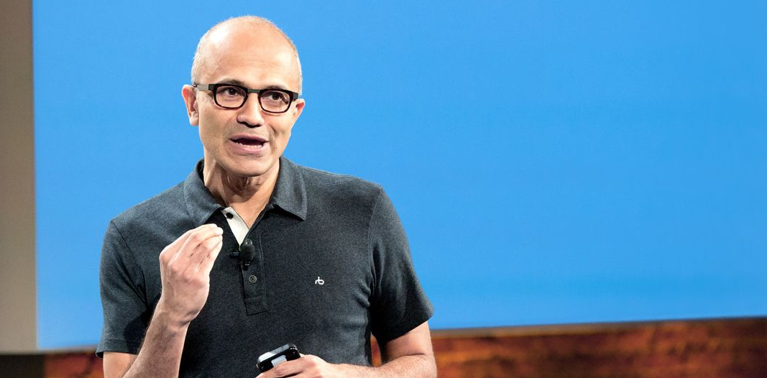
“Judge us by the actions we have taken in the recent past, our actions today and in the future”
—Satya Nadella, CEO Microsoft
2014

Slide 27
Resources
Azure DevOps YouTube Channel – See It
https://www.youtube.com/channel/UC-ikyViYMM69joIAv7dlMsA
Azure DevOps Hands-On Labs – Do It
https://www.azuredevopslabs.com/
Azure DevOps Documentation – Read about It
https://docs.microsoft.com/en-us/azure/devops
Azure DevOps Projects- Get Started Fast
https://azure.microsoft.com/en-us/features/devops-projects/

Slide 28
Q&A

Slide 29

Thank You

Slide 30
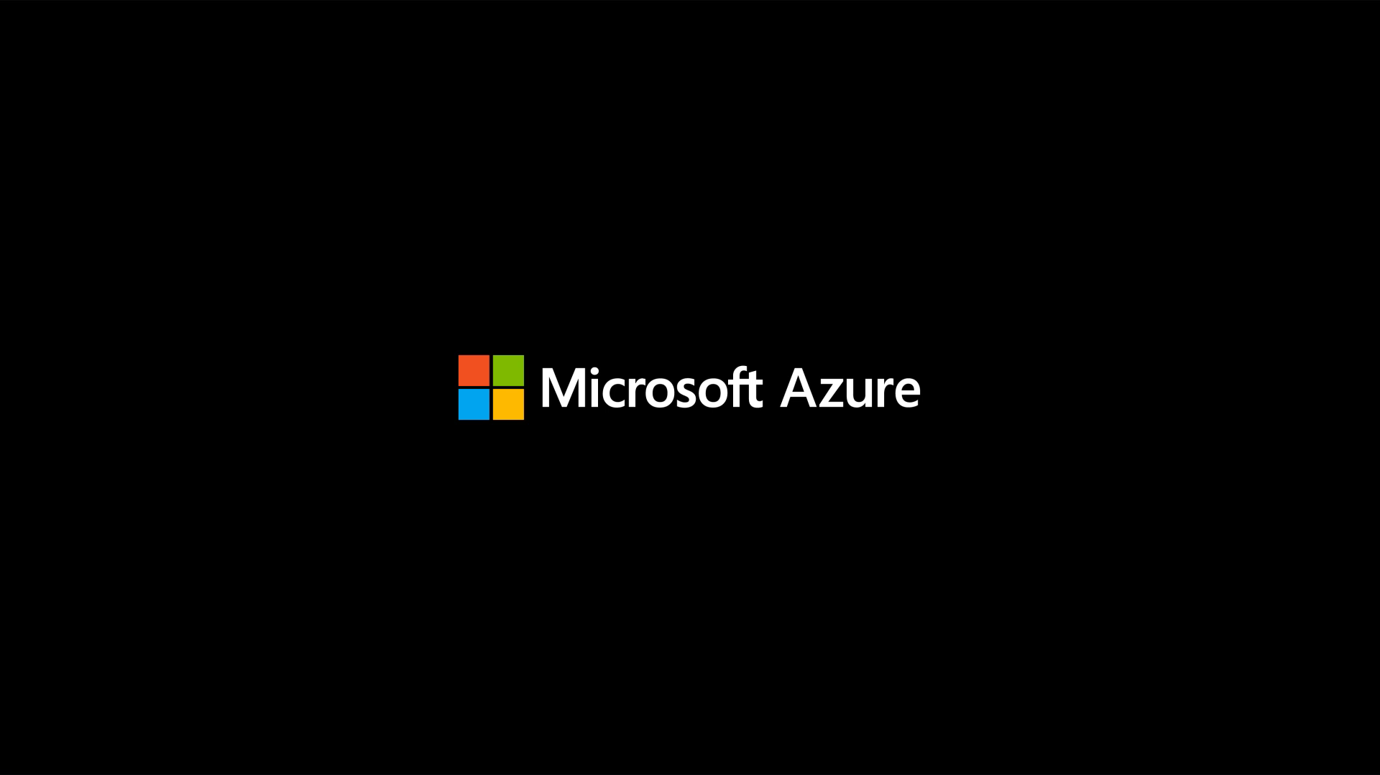

Slide 31

Thank you! Your Feedback is Important
Rate My Talk & Download Slides!
http://bit.ly/RateShawnsTalk
(case sensitive)
Contact Information
Email: sweisfel@microsoft.com
Blog: http://www.shawnweisfeld.com
Twitter: @shawnweisfeld

